Slide 1
Answering the Auditor’s Call with Automation
Andy Levy
He/Him
Database Administrator
Inspira Financial

Slide 2









Thank You! Sponsors

Slide 3

Andy
Levy
He/Him
Database Administrator
PowerShell fan zealot
In IT since 1999
Web dev & server administrator
Systems integrator
Database developer
Inspira Financial
https://linktr.ee/alevyinroc
FLXsql.com
andy@FLXsql.com

Slide 4
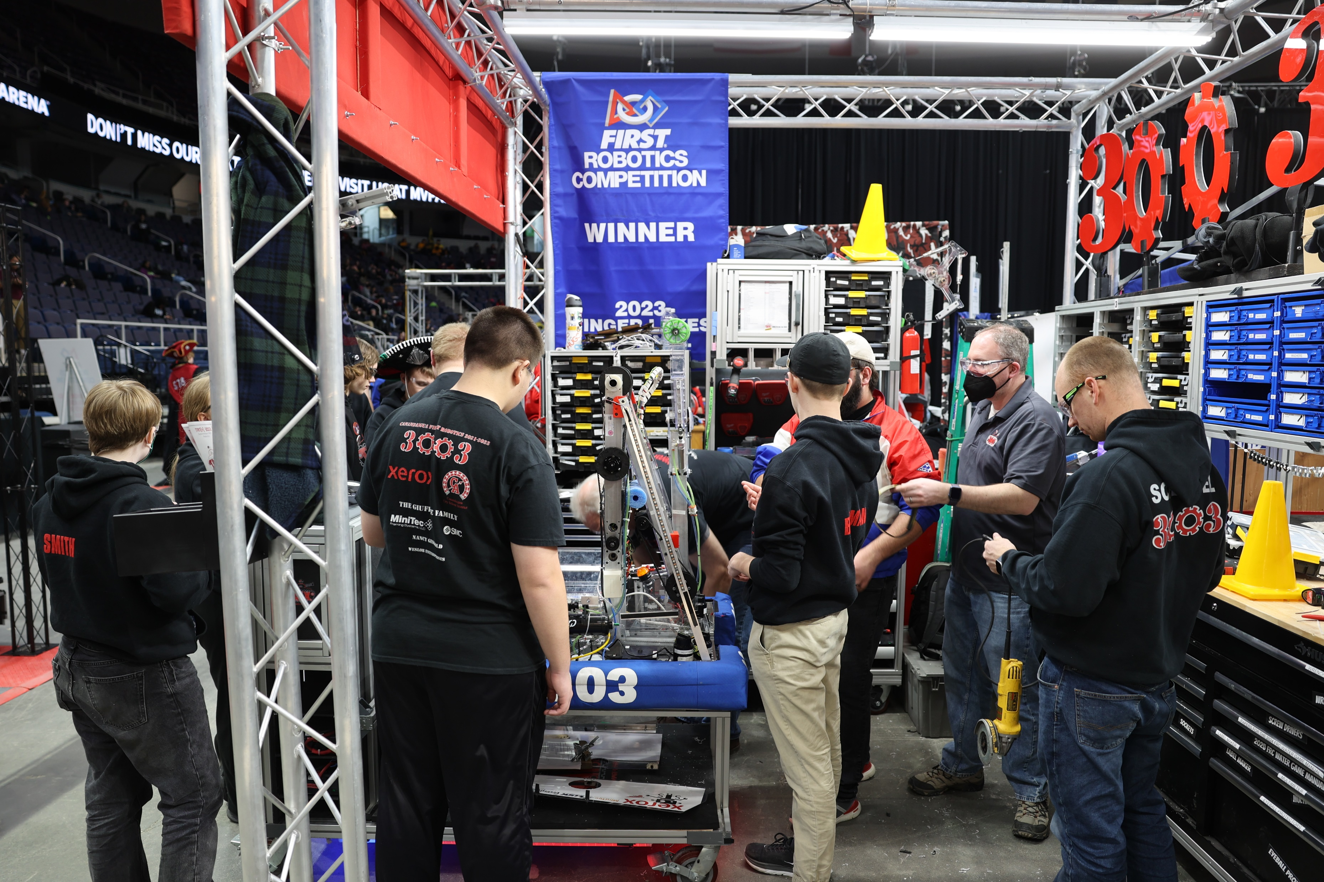

If(@CurrentActivity <> 'Work')

Slide 5
What Are We Covering?
Questions I get for SOC/SOC2 audits
Common things Infosec & auditors ask for
Documenting that we do the things we say we do
Making the process faster, repeatable, and less painful

Slide 6
What Are We Not Talking About?
Your specific requirements
SQL Audit
Licensing
Notes:
Each company has their own requirements around auditing, inventory, alerting, etc. This talk is meant to give you tools and a starting point so you can more efficiently and effectively answer questions
SQL Audit is its own thing. Josephine Bush (https://sqlkitty.com) has some good talks on SQL Audit
We aren’t doing this to make sure your licensing is all correct. Though you can use some of the data we’re collecting for that purpose

Slide 7
Questions I’m Asked
What SQL Server instances do we have?
Are we up to date on patching?
Who can access SQL Server?
Are you watching the ErrorLog?
Are we using encryption?
Is our data backed up?
Are integrity checks performed?
Provide a narrative of how the information was collected
Notes:
Including versions & patch levels
Integration with SIEM (Security information and event management)

Slide 8
Why Automate?
Save time
Repeatable
Code provides the narrative
So I can do the things I want to do

Slide 9

Is dbatools Safe?
Signed code
Every PR is tested
PowerShell Gallery scans for viruses
Chocolatey reviews packages
Build from source
Notes:
We’re talking about security & audit folks, after all

Slide 10
Demos!

Slide 11
Thank You!
https://linktr.ee/alevyinroc
FLXsql.com
andy@FLXsql.com

